Slide 1
Capstone Project 4
Online Retail Customer Segmentation
Team Member
Adarsh Kumar
Adil Imam
Md Sazil Sharif
Ankur sarkar
Data Science Trainee,
AlmaBetter

Slide 2
Business Objective :-
Customer segmentation is the practice of grouping the consumers of a firm into categories that represent the similarities among the customers in each category. In order to optimize each customer's value to the company, it is important to segment customers in order to determine how to interact with them.
Customer segmentation may enable marketers to reach out to each customer in the most efficient manner. A customer segmentation analysis enables marketers to accurately identify distinct groups of customers based on demographic, behavioural, and other factors by utilizing the vast amount of customer (and potential customer) data accessible.
Problem Description :-
In this project, your task is to identify major customer segments on a transnational data set which contains all the transactions occurring between 01/12/2010 and 09/12/2011 for a UK-based and registered non-store online retail. The company mainly sells unique all-occasion gifts. Many customers of the company are wholesalers.

Slide 3
Data Set :-
Invoice No: Invoice number. Nominal, a six-digit integral number assigned to each transaction specifically. This code denotes a cancellation if it begins with the letter "c.".
Stock Code: Product (item) code. A 5-digit integral number known as the nominal is assigned to each unique product.
Description: Name of the Product (Item). Nominal.
Quantity: The number of each item (product) in each transaction. Numeric.
Invoice Date: Invoice Time and date. The day and time that each transaction was created, represented by a number.
Unit Price: Unit pricing. Numeric, Sterling unit price for the product. Customer ID: Customer number. Nominal, a five-digit integral number assigned to every customer uniquely.
Country: Country name. Nominal, the name of the country in which each customer resides.

Slide 4
Contents :-
Import Dataset
Data Set Information
Data Pre-processing
Remove Duplicate
Exploratory Data Analysis (EDA)
Feature Engineering
Correlation Matrix
Analysing Numerical value
Unsupervised Learning Model

Slide 5

Libraries:-
Pandas
NumPy
Seaborn
Matplotlib
Datetime
Sklearn
SciPy
Pretty table

Slide 6
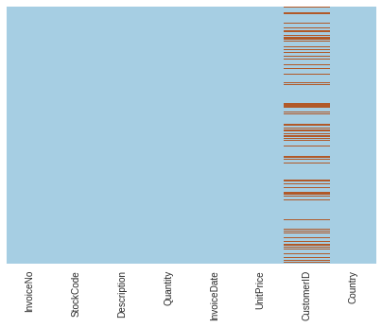
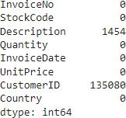
Data Pre-processing:
Null values
Heat Map
Null values present in Description
and CustomerID column includes exactly
1454 and 135080 null values.
Shining lines indicate null values.

Slide 7

Exploratory data analysis(EDA):-
Top 5 product based on maximum selling are :
White Hanging Heart T-light Holder,
Regency Cakestand 3 Tier
Jumbo Bag Red Retrospot
Party Bunting
Lunch Bag Red Retrospot
Bottom 5 Product based on the selling are
Ruby Glass Cluster Earrings
Pink Chrysanthemums Art Flower
72 Cake Cases Vintage Christmas
Wall Art , The Magic Forest
Paper Craft , Little Birdie

Slide 8
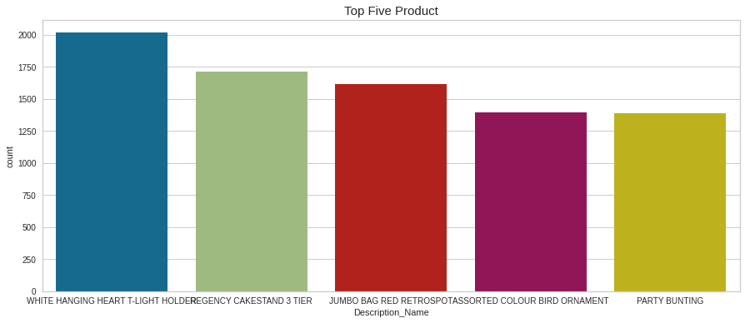
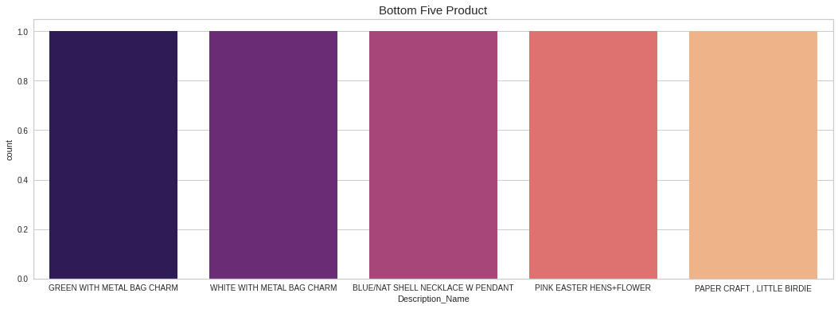
Visualization of Description:-
Top 5 product
Bottom 5 product

Slide 9
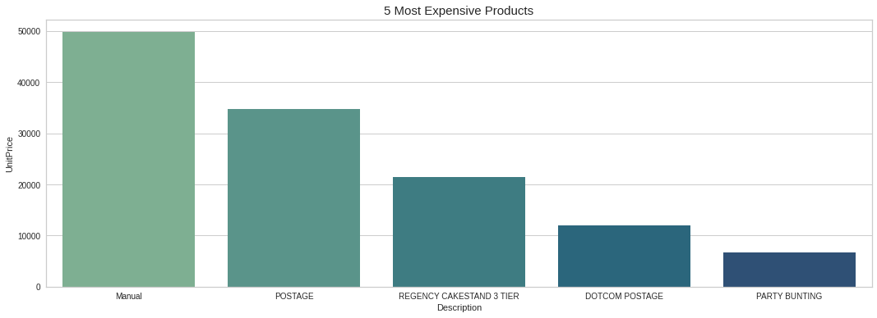
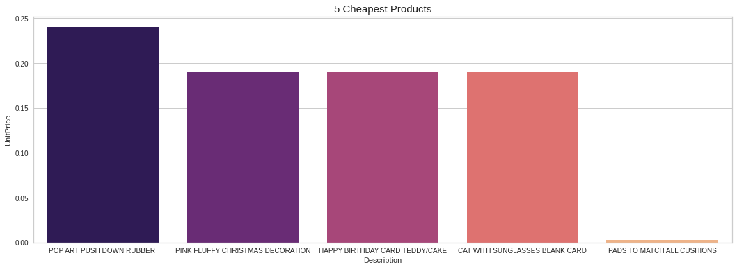
Most Expensive and Cheapest Products Per Unit:-
Manual is the costliest product and PADS TO MATCH ALL CUSHIONS is the cheapest product.

Slide 10
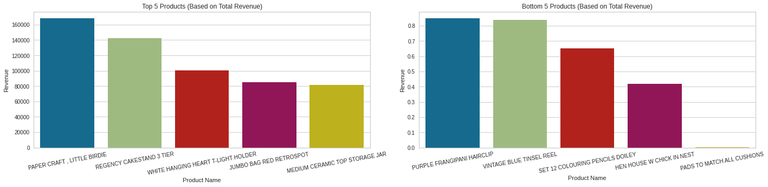
Top and Bottom Products (Based on Total Revenue):-
Paper Craft Little Birdie makes the most revenue and Purple Frangipani Hairclip makes the least revenue.

Slide 11
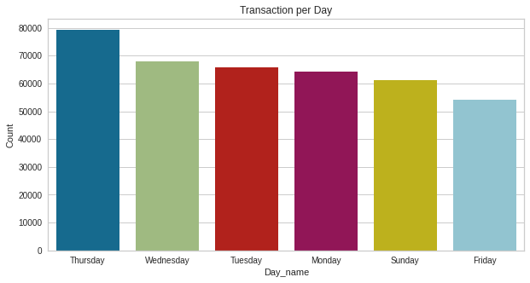
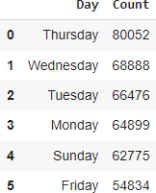
Transaction per day:-
From the above graph, it is clear that Thursday has higher transaction volume than the other days and Friday has lower transaction volume.

Slide 12
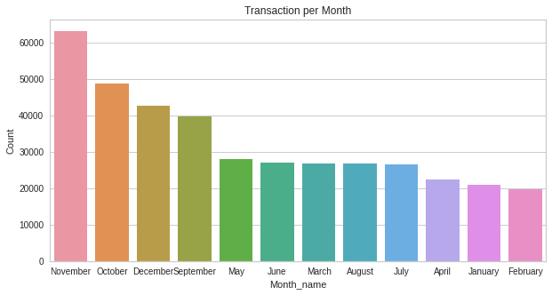
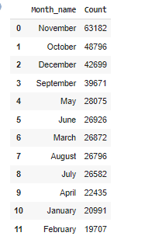
Transaction Per Month:-
November has highest transaction volume followed by October and December.

Slide 13
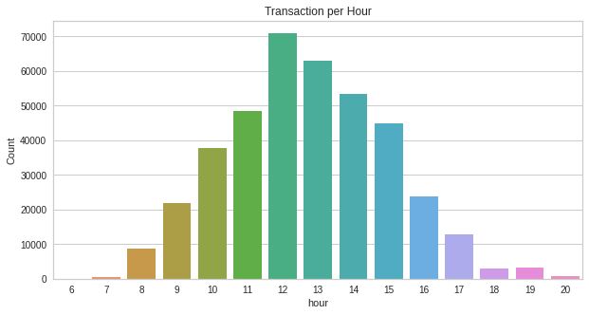
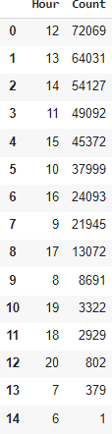
Transaction Per Hours:
According to hour, people do most of their shopping between the hours of 11 and 4, therefore practically all of them are free at this time.

Slide 14
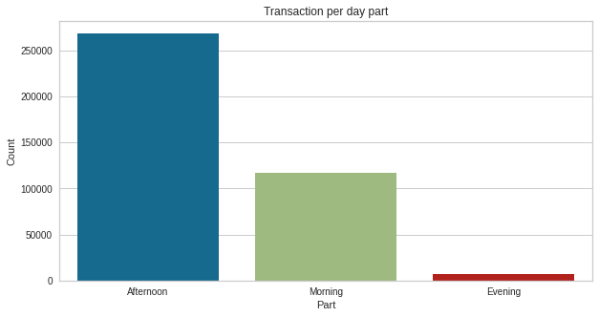
Transaction Per Day distribution:-
Most orders are placed in the Afternoon followed by Morning and Evening.

Slide 15
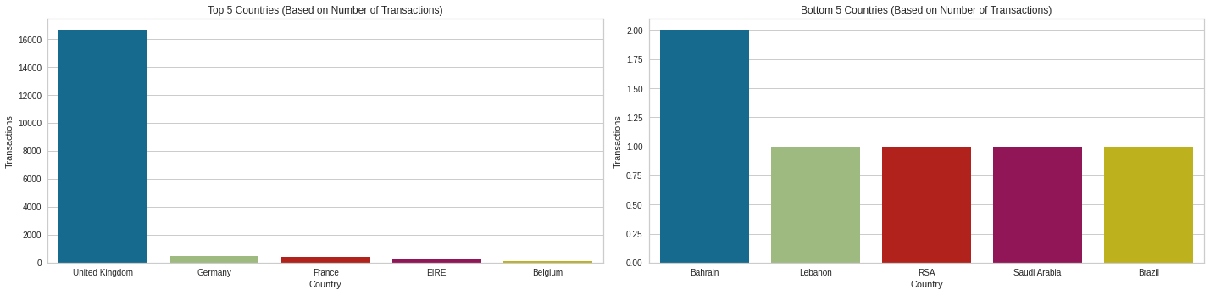
Top and Bottom Countries (Based on Number on transaction):-
From the above graph, it is clear that the United Kingdom has more transactions than other nations, followed by Germany, France, Ireland, and Belgium.
Bahrain has the least number of orders placed followed by Lebanon, RSA Country, Saudi Arabia and Brazil

Slide 16
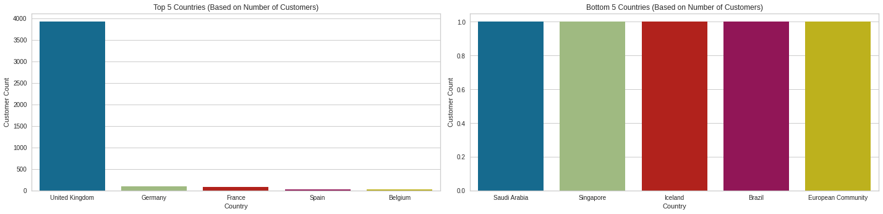
Top and Bottom Countries (Based on Number of Customers):-
United Kingdom has the highest no of customers from the top countries followed by Germany, France ,Spain and Belgium.
Saudi Arabia has the lowest no of customers from the bottom countries followed by Singapore, Ireland , Brazil and European Community.

Slide 17
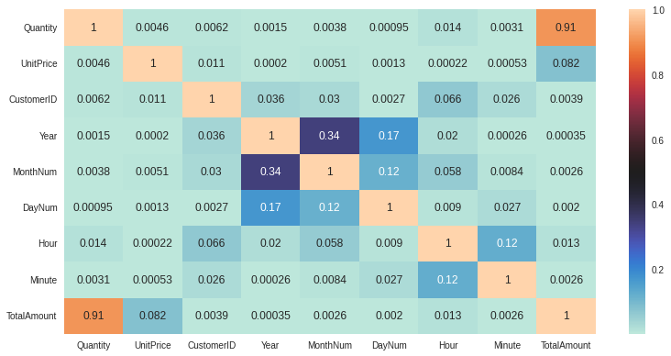
Correlation matrix:
As we can see Quantity and Total Amount are highly correlated.

Slide 18
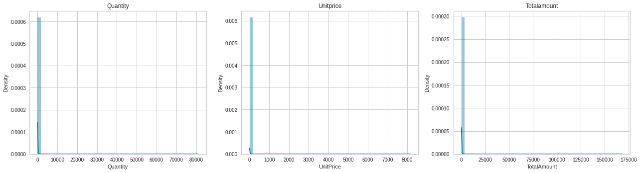
Distribution of Numerical Features:-
We can see that the 'Quantity', 'Unit Price', 'Total Amount' are all positively skewed,(mean > median > mode)
Ideally these features must be symmetric,(mean = median = mode) For this we must apply some kind of transformation to make these distributions close symmetric.

Slide 19
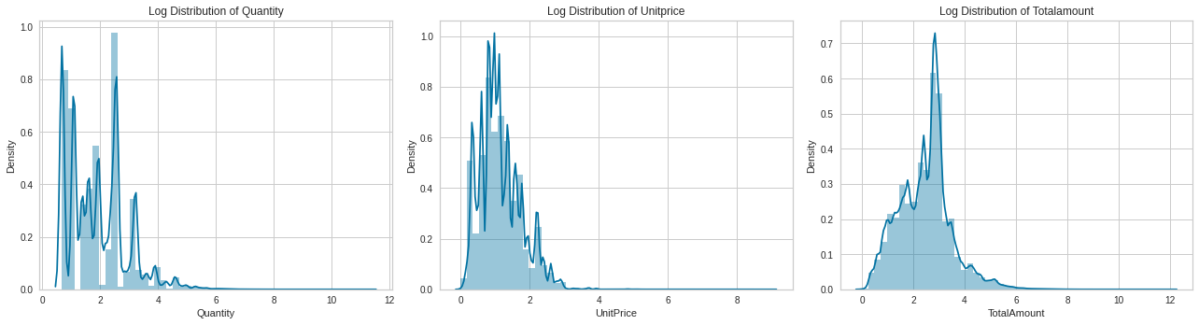
Distribution Of logarithmic
Transformed Features:-

Slide 20
Recency, Frequency, Monetary (RFM) Model
Recency, Frequency, Monetary value is a marketing analysis tool used to identify a company's or an organization's best customers by using certain measures. The RFM model is based on three quantitative factors
Recency: How recently a customer has made a purchase
Frequency: How often a customer makes a purchase.
Monetary Value: How much money a customer spends on
Performing RFM Segmentation and RFM Analysis:-
The first step in building an RFM model is to assign Recency, Frequency and Monetary values to each customer.
The second step is to divide the customer list into tiered groups for each of the three dimensions (R, F and M).
This approach does not require machine learning algorithms as segmentation can be done manually.
Creating RFM Dataframe:-
We will formulate the RFM dataset as follows
Recency = Latest Date - Last Invoice Data
Frequency = Count of invoice no. of transaction(s)
Monetary = Sum of total amount for each customer

Slide 21
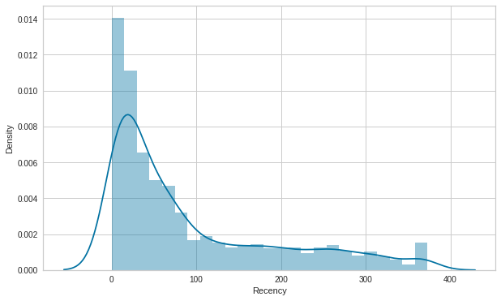
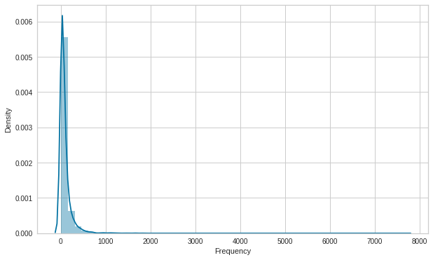
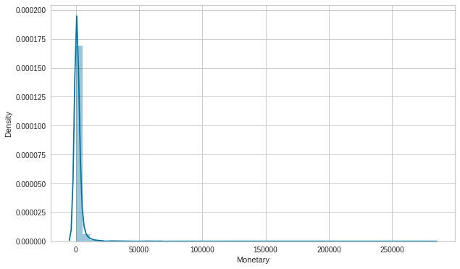
Distribution of Recency, Frequency and Monetary Features
The distributions all look skewed towards right.
We can transform these features to make the distributions as close to a normal distribution as possible.

Slide 22
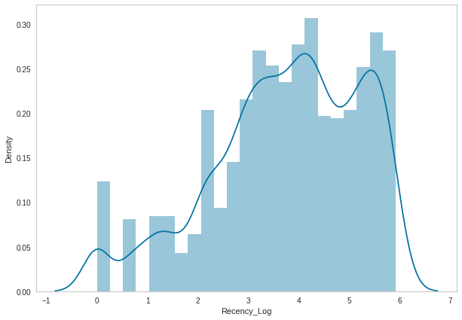
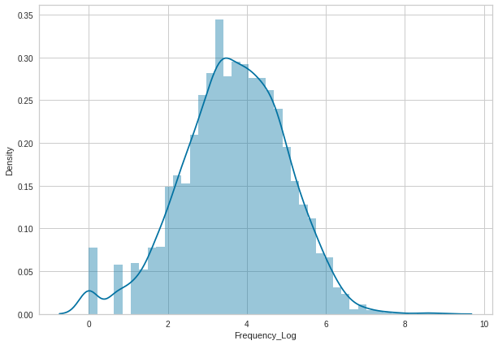
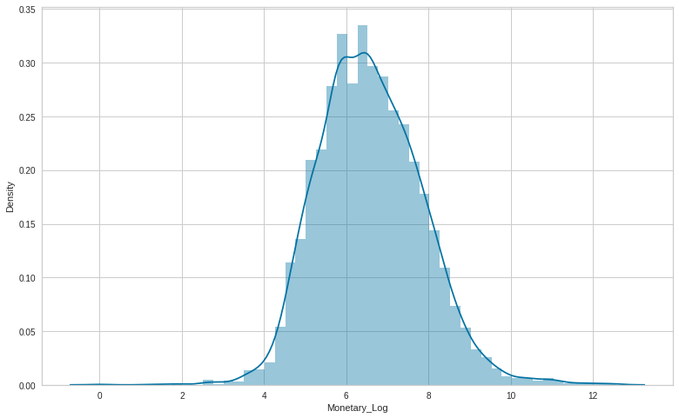
Distribution of log transformation:-
We used the log transformed values of Recency, Frequency and Monetary for prediction using Machine Learning Models.

Slide 23
K- Means Clustering Implementation:-
It can be summarized as the process of finding data subgroups where data points in the same subgroup (cluster) are extremely similar and other data points in other clusters are very different.
Finding Optimal Number of Clusters
There are two primary methods to define number of clusters:
Silhouette Score (math method)
Elbow criterion (visual method) Measures intra- and inter-cluster distance
Plot number of clusters against within-cluster sum-of- squared-errors (SSE)-sum of squared distances from every data point to their cluster canter.
•
•
•
•
•
•

Slide 24
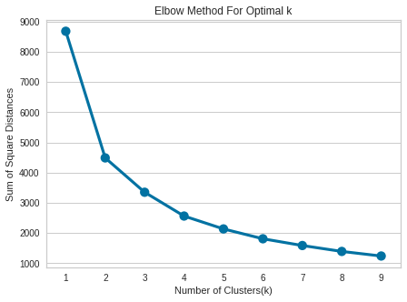
Elbow Method on Recency and Monetary:-
The graph for the sum of square distance values and Number of Clusters

Slide 25
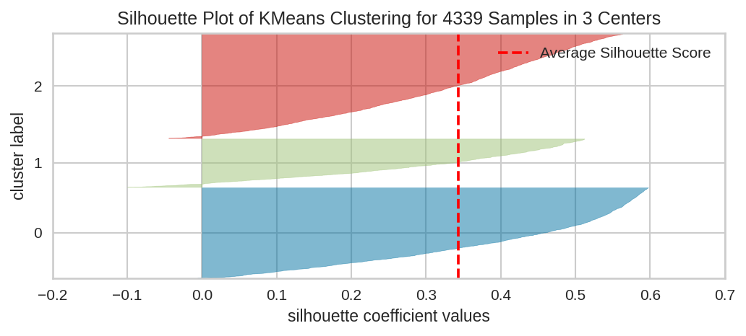
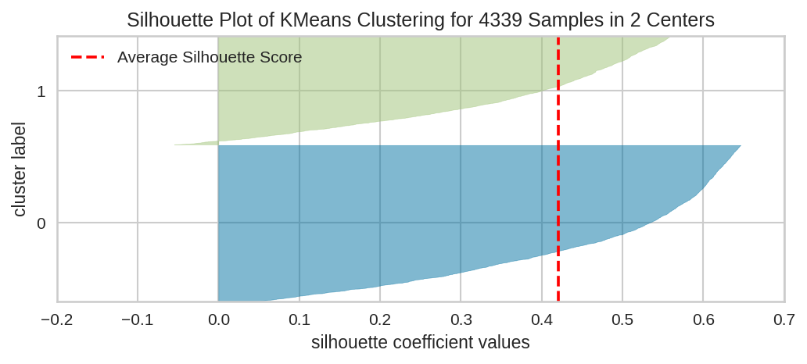
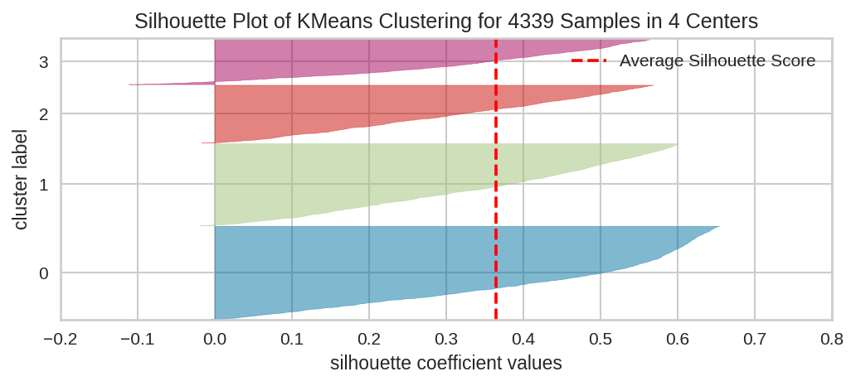
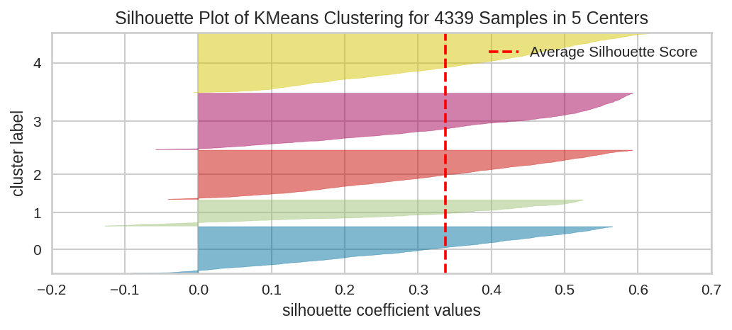
Visualising Silhouette Analysis for n-clusters:-

Slide 26
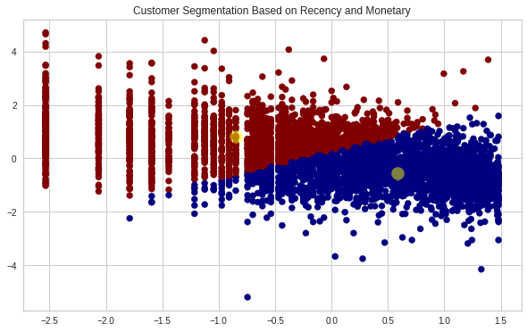
Hyperparameter Tuning For the Best Value of K
Customer segmentation by taking k=2
When we separate customers by Recency and Monetary value, we can observe that they are well-separated.

Slide 27
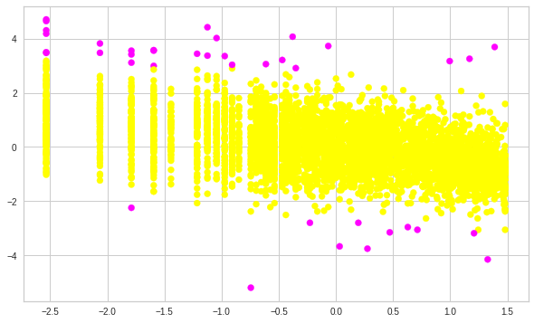
Implementation of Density Based Spatial Clustering of Applications with Noise (DBSCAN):-
DBSCAN on Recency and Monetary

Slide 28
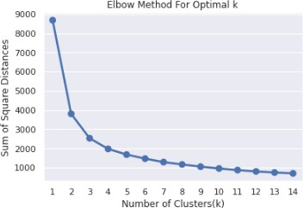
The graph for the sum of square distance values and Number of Clusters

Slide 29
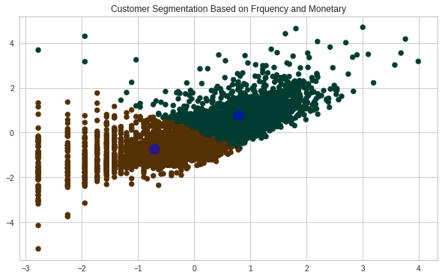
Hyperparameter Tuning For Best Value of K:-

Slide 30
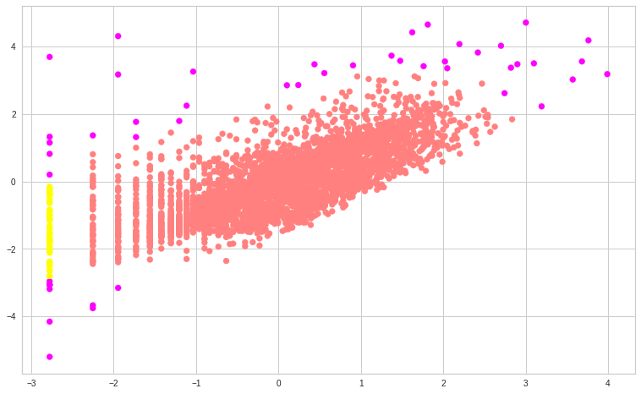
DBSCAN on Frequency and Monetary
DBSCAN method on Frequency and Monetary

Slide 31
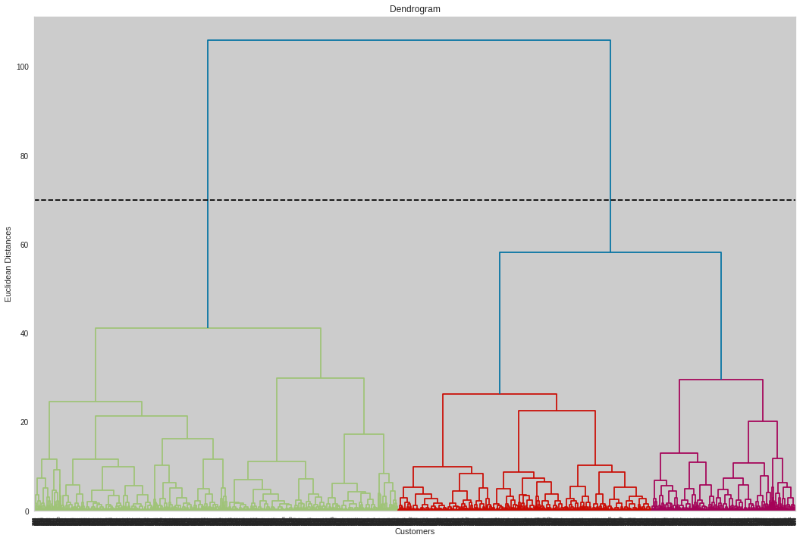
Hierarchical Clustering
The number of clusters will be the number of vertical lines which are being intersected by the line drawn using the threshold=90
No. of Cluster = 2

Slide 32
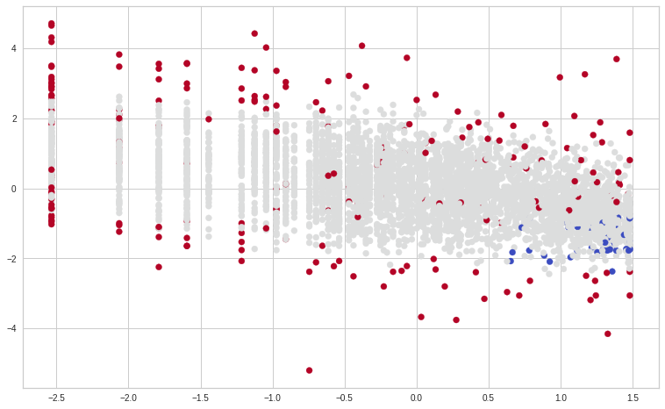
DBSCAN to Recency ,Frequency and Monetary
we see that ,Customers are well separate when we cluster them by Recency ,Frequency and Monetary and optimal number of cluster is equal to 3

Slide 33
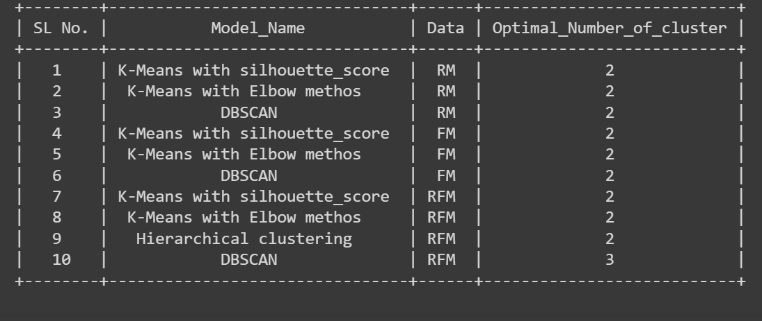
Model-Cluster summary

Slide 34
Conclusion:-
Initiating the task, we found that our raw data contains about 25% missing values and we also found some duplicate values. We performed data cleaning to get rid of these values and also cancelled orders.
We derived important business insights based on products, time and location.
We also performed feature engineering. This included deriving new date and time features and getting a new feature giving the total amount of transaction using price and quantity of order.
We then performed RFM analysis of the transaction data. This helped us gain importance metrics to build models for customer segmentation
Model building included Segmentation Using RFM Scores(Heuristic Model) which gave us 4 major segments
1.As K-means has the high score , it can be as used for the segmentation.
2.The model can help to segment the customers on the basis on which their activities
3.The model helps to segment customer as it helps to target them with their interests with similar customers.

Slide 35
THANK YOU

